Slide 1
READ ME This template uses the font ‘Space Grotesk’ – be sure to download the font before making edits to the deck. Here’s the link to the ZIP file containing the font. If you cannot access the link above, you can download the font for free via Google Fonts.

Slide 2
Blazor JS Interoperability

Slide 3
Can I use React components in Blazor?

Slide 4
Yes, you can!

Slide 5
It’s because of JS interoperability

Slide 6
Calling JS functions from .NET

Slide 7
Calling .NET methods from JS

Slide 8
Add React UI component to Blazor

Slide 9
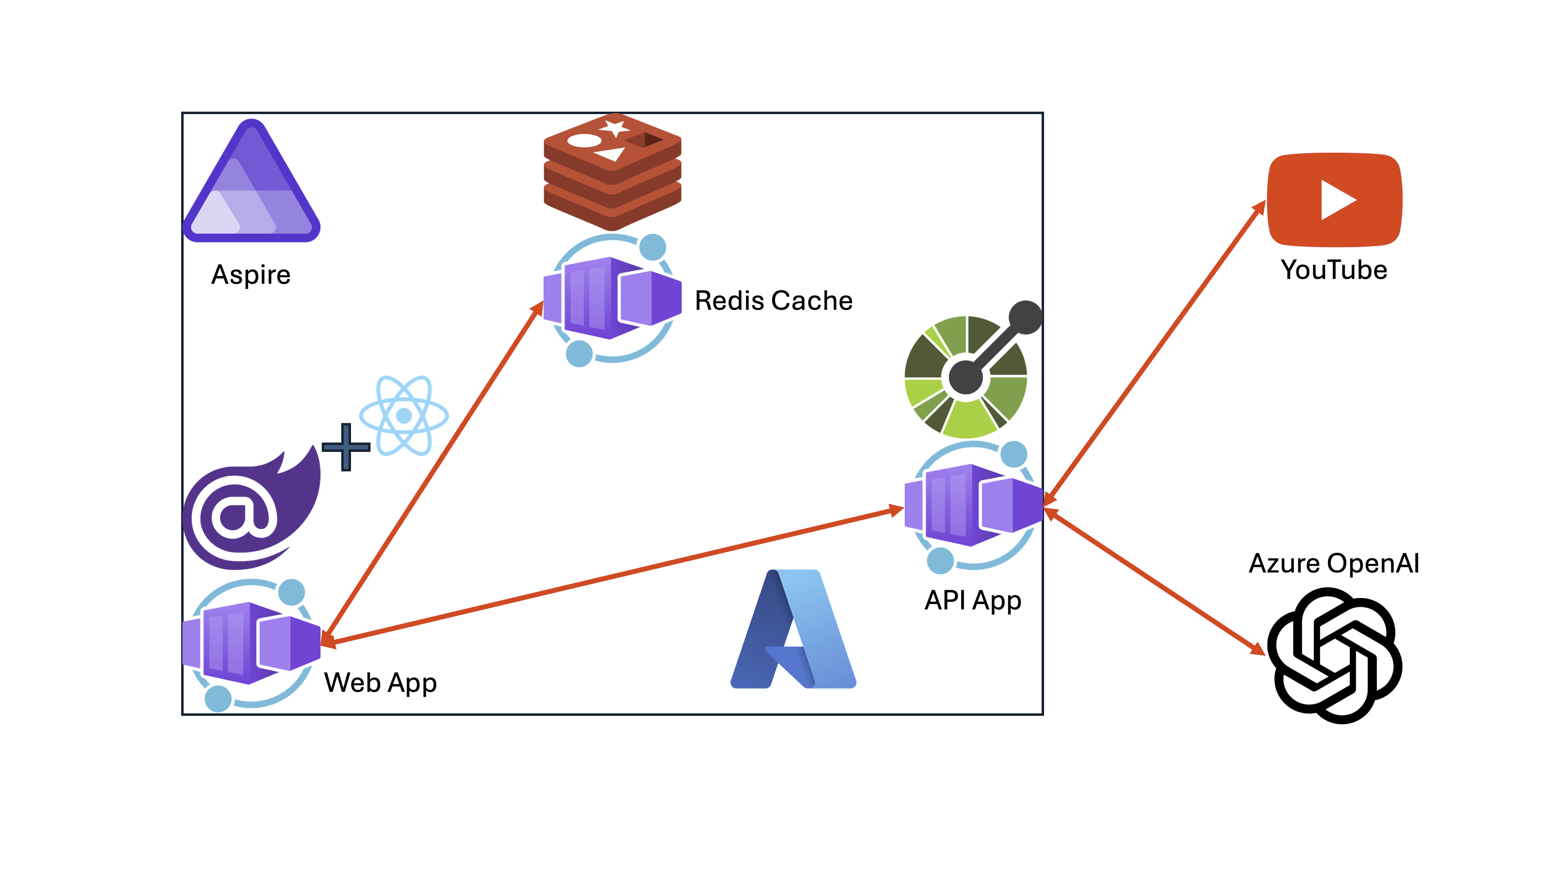

Slide 10
Let’s get started!
https://aka.ms/aspireinadaykr

